Slide 1
Importance of Data for Informed Decision Making
Solomon Islands Environment Data Portal

Slide 2
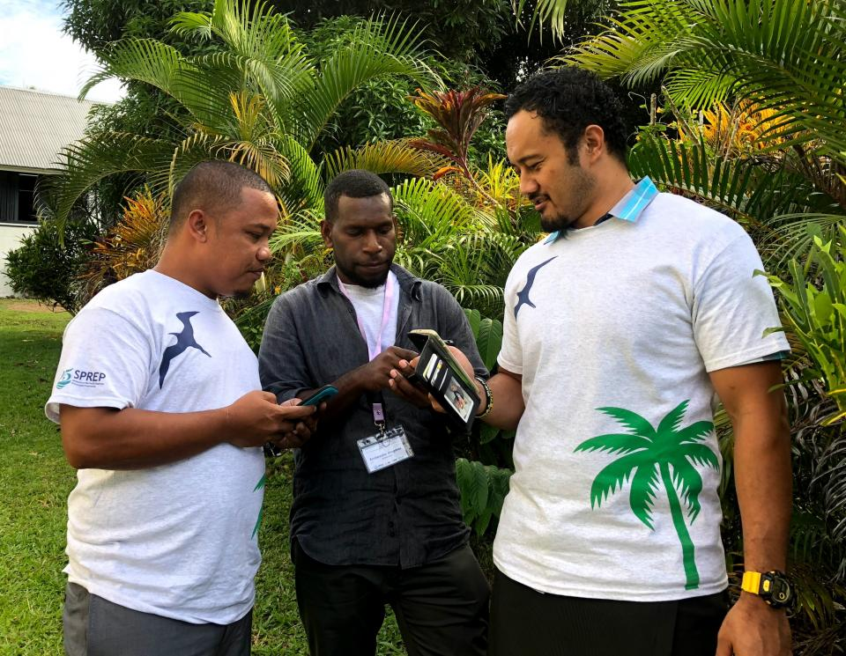
Definition: Environmental data encompasses information related to various aspects of the environment, including air quality, water resources, biodiversity, climate patterns, and more.
Importance: Environmental data serves as a critical tool for understanding, monitoring, and managing impacts on the environment.
“… without information, things are done arbitrarily and one becomes unsure of whether a policy or program will fail or succeed. If we allow our policies to be guided by empirical facts and data, there will be a noticeable change in the impact of what we do.”

Slide 3
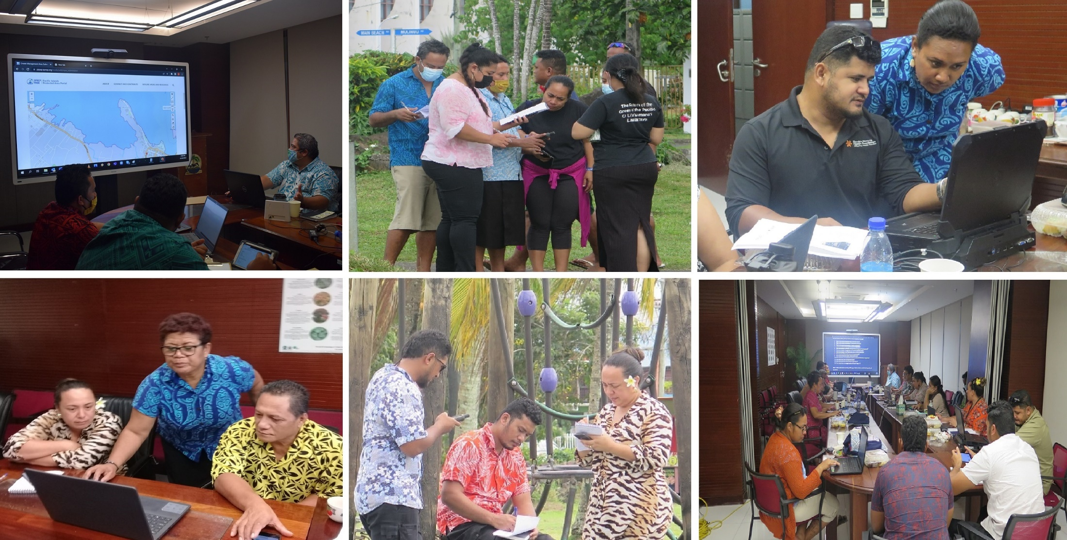
IMPORTANCE OF DATA IN DECISION MAKING
Data-Driven Decisions: Utilizing environmental data enables evidence-based decision-making processes.
Risk Assessment: Environmental data helps assess potential environmental risks and develop mitigation strategies.
Long-Term Planning: Data provides insights for long-term environmental planning and sustainability initiatives.

Slide 4
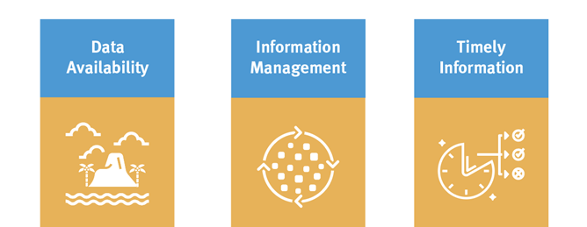
Regional Challenges
Lack of data as evidence of the environmental resources, trends and drivers of environmental change
The need for standard procedures for collecting and aggregating relevant data
Lack of timely access to available information by those who need it and for sound and informed decision making

Slide 5
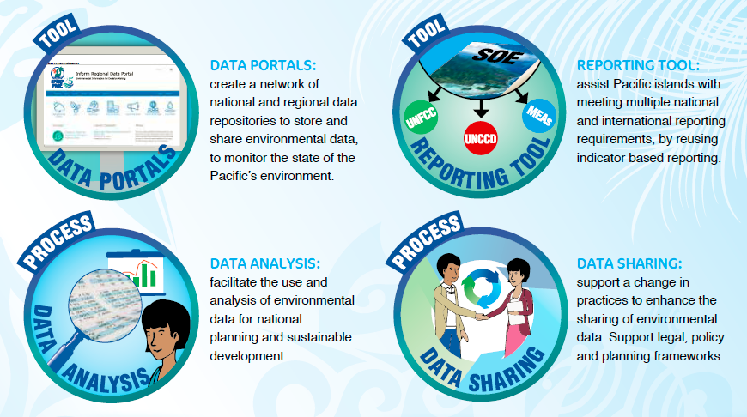
Existing Tools for Solomon Islands : Data Portal

Slide 6
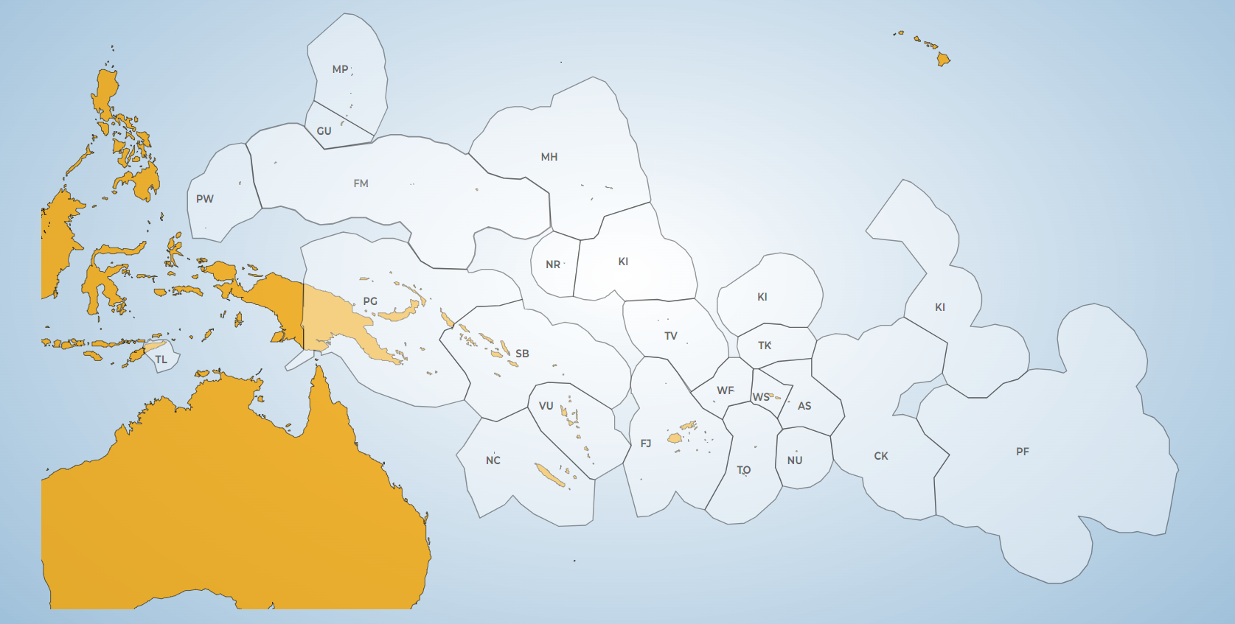
Network of Environment Data Portals
Repository where data is stored (online database)
Publishing platform
Data sharing platform on different levels (public/shared/private)
Open-source tool (DKAN)
Cloud or in country hosting

Slide 7
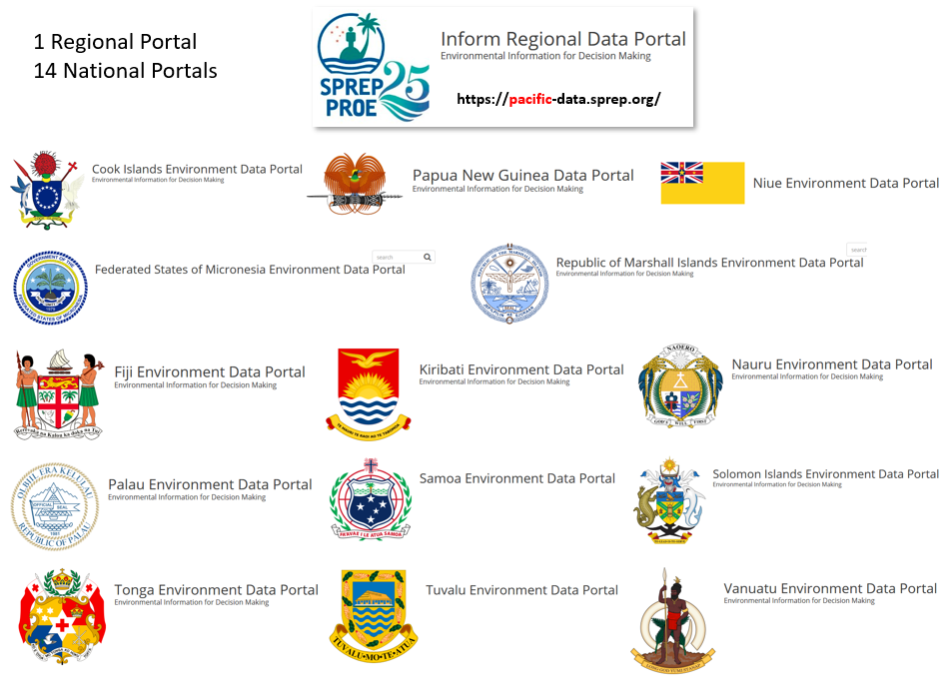

Slide 8
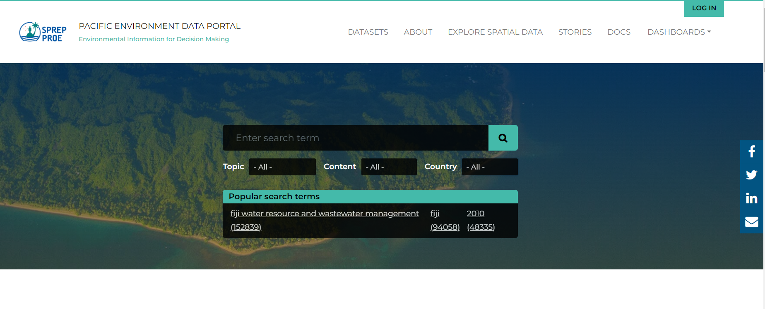
Pacific Environment Portal – https://pacific-data.sprep.org/
MENU

Slide 9
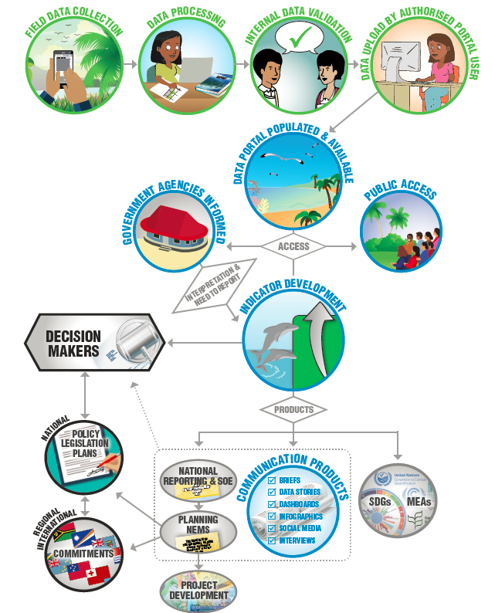
Making data discoverable - Providing the infrastructure and process for reliable, cross-system metadata management and access
Making data accessible - make data easily and quickly accessible to technical and non-technical users
Making data reliable

Slide 10
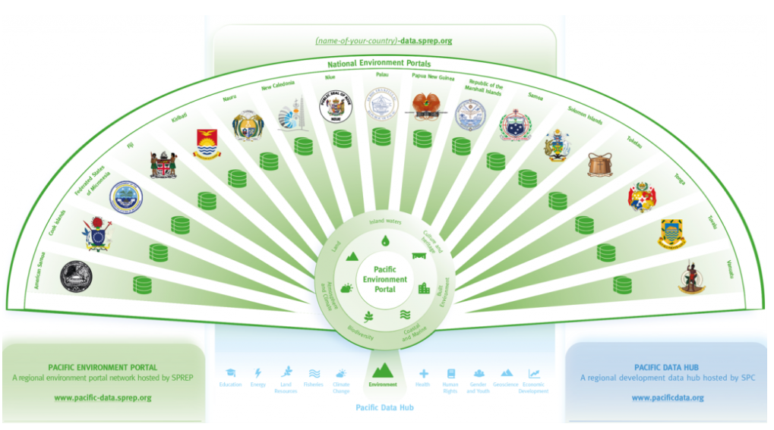
Pacific Data Ecosystem

Slide 11
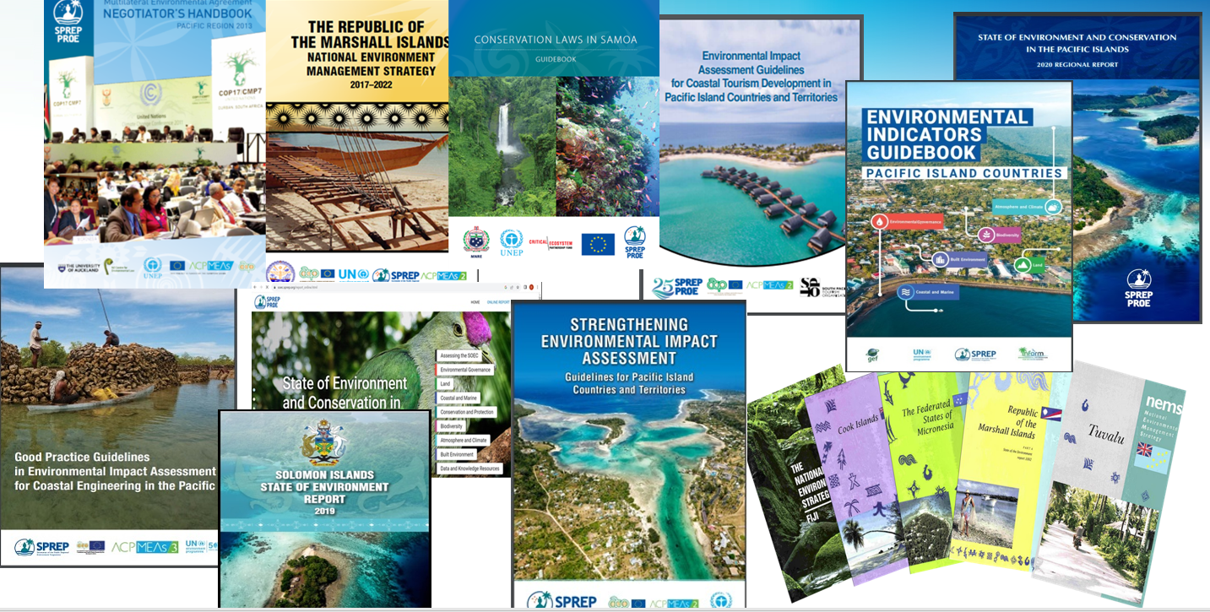

Slide 12
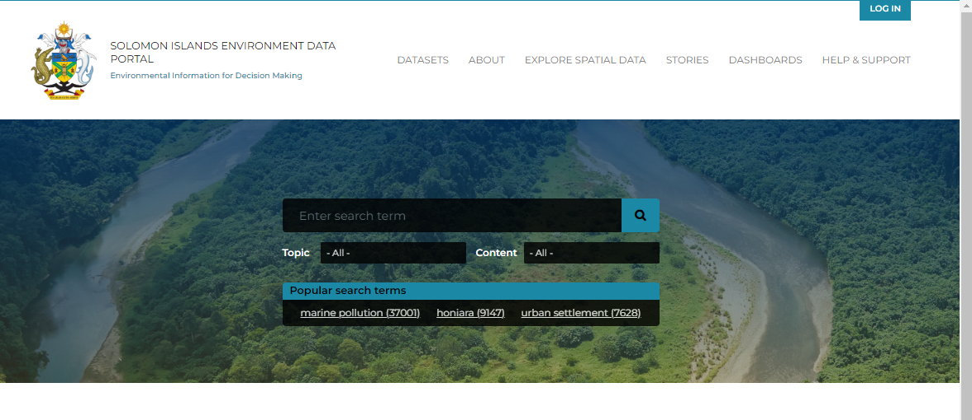
Introduction to the Solomon Islands Environment Data Portal
MENU
SEARCH
https://solomonislands-data.sprep.org/

Slide 13
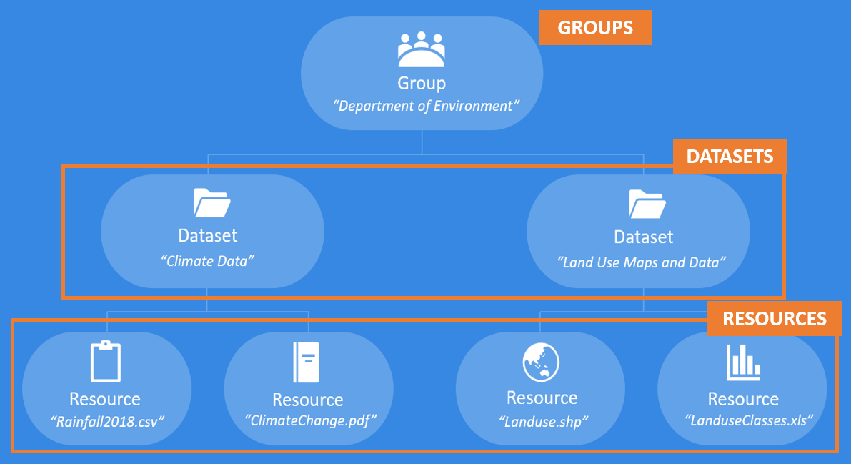
Portal Building Block:

Slide 14
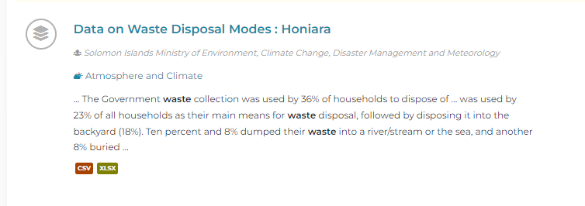
DATASET
RESOURCE

Slide 15
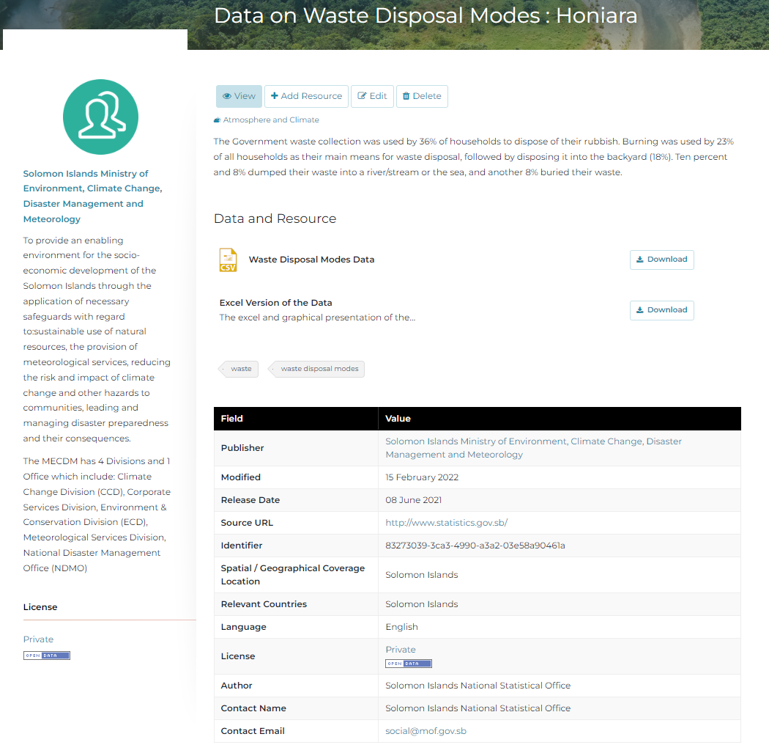
1) ADD DATASET
2) ADD RESOURCES
3) ADD METADATA
LICENSE LEVEL

Slide 16
License levels
Public
data accessible to all portal groups and the public
Shared
data shared between ministry portal groups, but not with the public
Private
data for internal use, only accessible within a single portal group

Slide 17
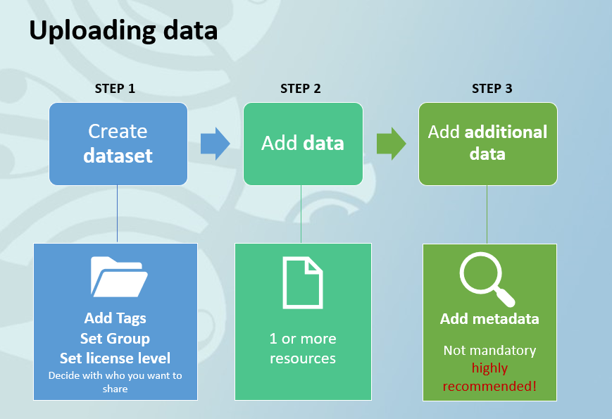

Slide 18
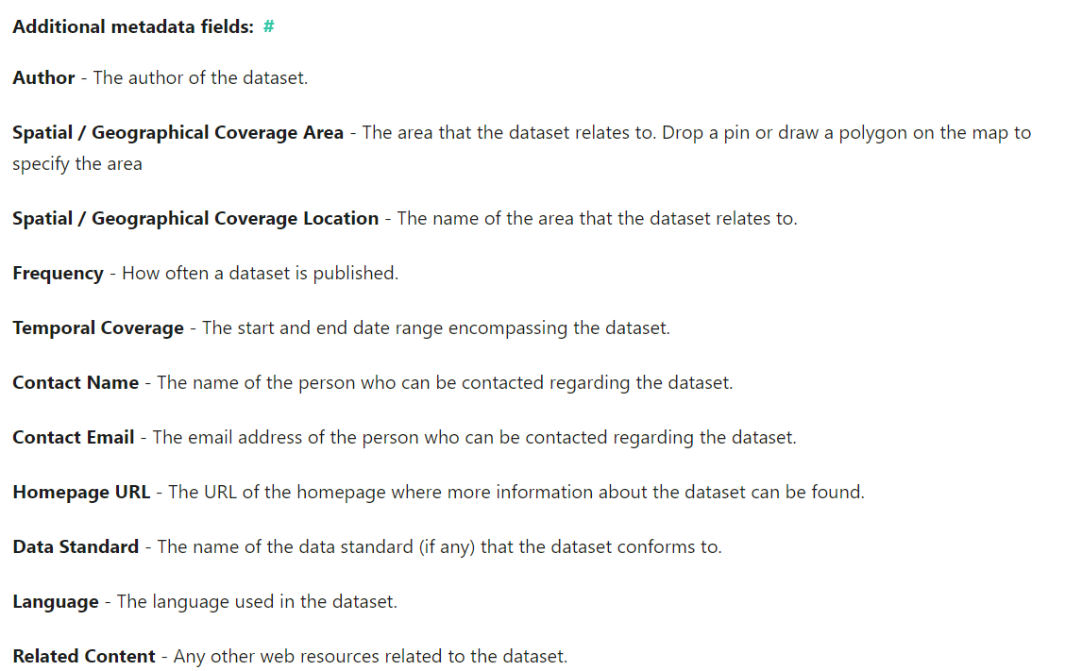

Slide 19

What type of data can you upload?
The data portal supports many file types, including:
csv, html, xls, json, xlsx, doc, docx, rdf, txt, jpg, png, gif, tiff, pdf, odf, ods, odt, tsv, geojson and xml

Slide 20
ONLINE PORTAL SESSION/DEMO:
Web address : https://solomonislands-data.sprep.org/
Top right Corner - please login using your email and the following password:
solomonIslandsPortal24!

Slide 21
GOOD DATA PRACTICES
Avoid double data
Check the portal to see if the same dataset has already been uploaded
→ Do a quick search by using keywords
Maybe your new data resource is best placed under an existing dataset?
  Examples:
  You are uploading a new version of the same data
  You found a report that provides background information on raw data in Excel already uploaded to the portal.

Slide 22
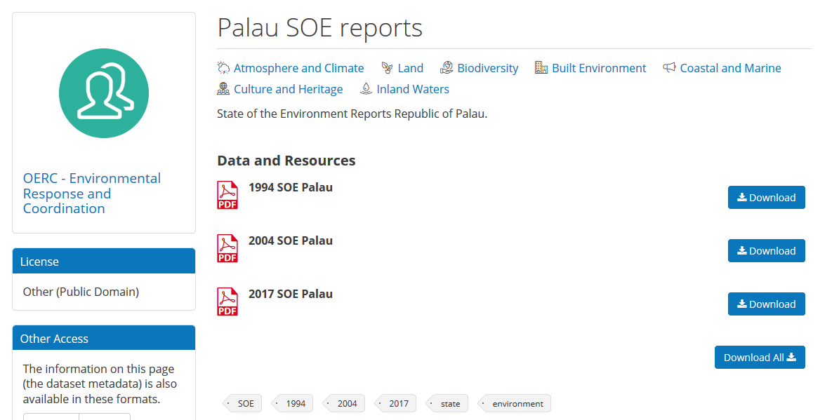
Consider grouping your data resources
Group different resources under one dataset, when relevant
Be aware of not grouping too much
Only group resources when they are strongly related
Avoid that other users are not able to find your data
A good example of grouping different resources :

Slide 23
Metadata are crucial
It is not mandatory, but really good practice to take the time to add additional data about the dataset.
➔ Other users will know who can be contacted, when the dataset was collected, what to be aware of when using the dataset etc.

